Slide 1

Database Information Management Updating records using PHP
KF4009 Web Technologies
2018/19

Slide 2
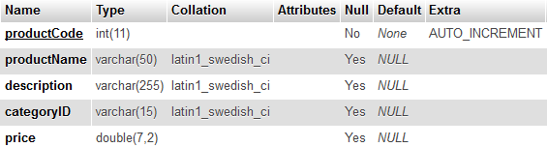
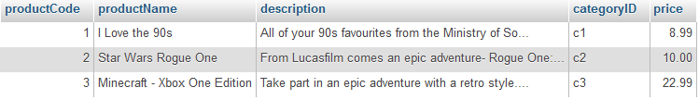
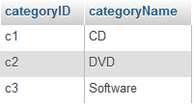

An example database
products table
p_category table
Notes:
2

Slide 3
General steps to update records
Generate & display a form
Form action links to script to process form
Process script:
Retrieve variables from the request
Check variables are valid
If not valid then
Give error message
else
sanitise those variables
Connect to server
Construct SQL query
Execute query
Link back…
Note the steps are similar to those for inserting
Note also that for clarity on the slides we won’t repeat all of the checking, sanitising and linking back steps that you looked at earlier – you would need to do them of course

Slide 4
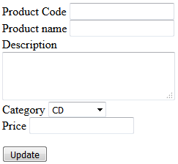
Updating a record – example form
<form method="get"
action="updateProduct.php">
Product Code
<input type="text" name="productCode">
Product name
<input type="text" name="productName">
Description
<textarea name="description"></textarea>
Category
<select name="categoryid">
<option value="c1">CD</option>
<option value="c2">DVD</option>
<option value="c3">Software</option>
</select>
Price
<input type="text" name="price">
<input type="submit" value="Update">
</form>
The form collects the new field values and passes them as parameters to the server
A php script will then access the parameter data and use it to update a record in the products table
Notes:
We use method get only for testing

Slide 5
The update process
Retrieve the variables. Example:
$price = isset($_REQUEST['price']) ?
$_REQUEST['price'] : null;
Remember you would validate before doing the following, see last week’s slides
Connect to the server (as you have already learnt to do)
Remember you would also sanitise before continuing, see last week’s slides
Construct the sql query, but using the retrieved variables:
$updateSQL = "UPDATE products SET
productName = '$productName',
description = '$description',
categoryid = '$categoryid',
price = $price
WHERE itemCode = $productCode";
Execute the query
$success = $dbConn->query($updateSQL);
Substitute the values of the variables (the data from the web form)

Slide 6
Improving the update process
How could we improve on the previous update example?
We could allow the user to select a record to modify from a list of records and then have the current details for that record displayed in a form ready to change
Possible methods include
Provide a clickable list of hyperlinks to choose from, good when there are lots of fields and many records, however, if there aren’t many choices then:-
Provide a SELECT list of options to choose from
Provide a list of checkboxes to choose from

Slide 7

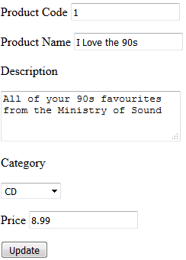
Updating using hyperlinks – process overview
When clicked a link passes the product code of the selected record (we always link on the primary key) to the server via a query string where a script can use it to create a form that displays the current full details of the selected record
On submission the modified details are sent to the server where an update script can use them to update the specified record
PHP update script

Slide 8
The hyperlink list
<a href='updateProductForm.php?productCode=1'>
I Love the 90s</a> CD 8.99
<a href='updateProductForm.php?productCode=3'>
Minecraft - Xbox One Edition</a> Software 22.99
<a href='updateProductForm.php?productCode=2'>
Star Wars Rogue One</a> DVD 10.00
How to create the hyperlinks?
‘pre-code’ them or
dynamically build them by querying the products table and generating the required HTML for the links using the query results
This would make sure that the list is up to date

Slide 9
Dynamically building the hyperlinks
How could we dynamically build them?
Answer:
Query the database to get the full set of product records
Iterate through them and echo one hyperlink for each to the browser

Slide 10
Building the hyperlinks - querying part
Connect to the server (as you have already learnt to do)
Construct the sql query we need
$querySQL = "
SELECT productCode, productName, categoryName, price
FROM products
INNER JOIN p_category
ON p_category.categoryid = products.categoryid";
Execute the query
$queryResult = $dbConn->query($querySQL);

Slide 11
Building the hyperlinks – iterate
Iterate over (loop through) the query results
while($rowObj = $queryResult->fetch_object()){
echo "<div>
<a href=
'updateProductForm.php?productCode={$rowObj->productCode}' >{$rowObj->productName}</a>\n";
echo “{$rowObj->categoryName} {$rowObj->price}</div>\n";
}
For each record, create a link to an update form with its productCode in a query string

Slide 12
The update form with current details (1)
Steps
Get the productCode passed by the hyperlink. How?
$productCode = isset($_REQUEST['productCode']) ? $_REQUEST['productCode'] : null;
Construct an SQL query to retrieve the full details of the record for the given productCode. How?
$querySQL = "
SELECT productCode, productName, description, products.categoryid, price
FROM products
WHERE productCode = $productCode"//you must sanitise this
Execute the query
$queryResult = $dbConn->query($querySQL);

Slide 13
The update form with current details (2)
If the query was successful, now fetch and store the record returned by the query
$rowObj = $queryResult->fetch_object();
Why is there only one record?

Slide 14
The update form with current details (3)
Create a form and pre-populate it by setting the values we now have for productCode, productName, description, category and price as defaults (using the value attribute for the input)
echo "<form method='get' action='updateProduct.php'> Product
Code
<input type='text'
name='productCode' value='$productCode'>
Description
<textarea name='description'>{$rowObj->description}
</textarea>
// Code for category and price would go here
<input type='submit' value='Update'>
</form>";

Slide 15
The update form with current details (3a)
However, we wouldn’t want the user to update the primary key, but that primary key must be in the form so it’s sent to the update script. There are two ways we might do this:
Hide the input
<input type='hidden'
name='productCode'
value='$productCode'>
Make the input readonly
<input type='text'
name='productCode'
value='$productCode' readonly>

Slide 16
The populated update form
Example: the update form produced if record 1 is selected
The user could now modify this record
Clicking ‘Update’ would call an appropriate PHP script, e.g. updateProduct.php (with SQL UPDATE code in it) to modify the database
Note that here we are displaying the default (currently chosen) category name. Think about how you could do that

Slide 17
Creating a select list for update
The select list must show all the records but ‘preselect’ the correct one.
Create a new sql statement for, say, category:
$sqlCat = "select categoryID, catName from p_category order by catName";
$queryResult = $conn->query($sqlCat);
Execute and iterate displaying each one, using php and echo:
echo "<select name='categoryID'>";
while ($cat = $queryResult->fetch_object()) {
echo "<option value='{$cat->categoryID}'> {$cat->catName} </option>";
}
echo "</select>";
etc

Slide 18
Creating a select list for update
To preselect the correct one you must add the ‘selected’ attribute inside the <option>. We preselect the one whose categoryID matches the categoryID we have:
if ($product->categoryID == $cat->categoryID) { $selected = 'selected'; }
else { $selected = ''; }
echo "<option $selected value='{$cat->categoryID}>";
etc
Notes:
echo "<select name='catID'>"
while ($cat = $catRS->fetch_object()) {
if ($product->categoryID == $cat->categoryID) { $selected = 'selected'; } else { $selected = ''; } echo "<option $selected value=' {$cat->categoryID} '>{$cat->catName}</option>\n";
}

Slide 19
Review / Summary
To manage (add, update etc.) MySQL database records via a web based system we need appropriate web forms and to construct and execute appropriate SQL queries using mysqli::query()
You can create interfaces that allow the user to
Select a record to modify (or perhaps to delete) from a list of records stored in a database table
Display the current field values of a selected record in an update web form (to help the user)

